Slide 1
Euro option Pricing Method
Speaker: Baiji Ye(by2351), Charlie Yi(cy2578), Ruibin Jacky Chen(rjc579)
Instruction by Professor Daniel Totouom-Tangho

Slide 2
Introduction
Black Scholes Merton Model (BSM)
Heston Model
Merton’s Jump-Diffusion Method

Slide 3


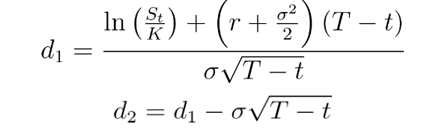
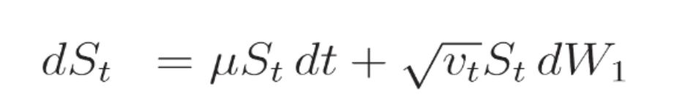
Black Scholes Merton Model (BSM)
Underlying Assumptions:
Constant dividend rate
Constant Risk-free rate
Stock Price follows a Geometric Brownian Motion (GBM)
No transaction cost or additional costs for options
No arbitrage opportunity during the entire duration of options.
C(S,t) = Call option price
P(S,t) = Put option price
S(t) = stock price at time t.
K = Strike Price
r = rate
N() = standard normal distribution

Slide 4
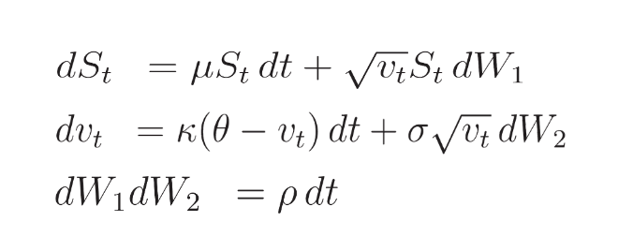
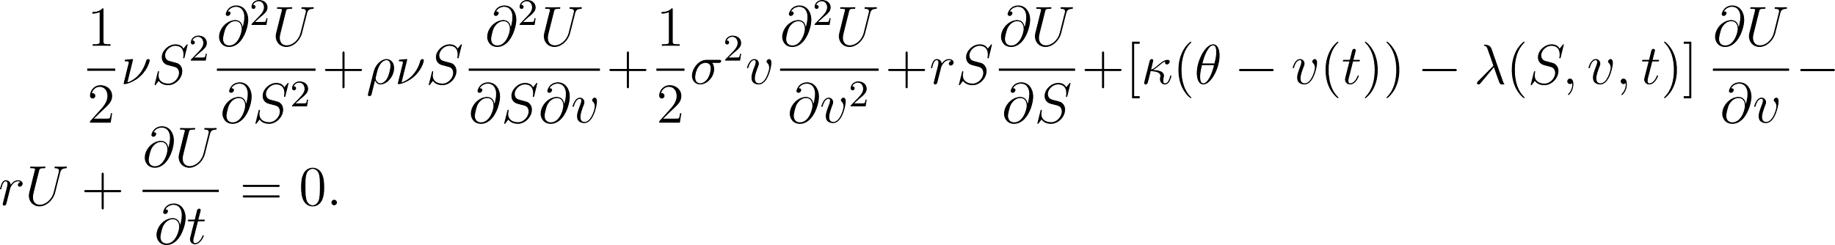
Heston Model Basic Assumption
Basic Assumptions:
Stock price follows a Geometric Brownian Motion
dvt follows a Cox-Ingersoll Ross method (CIR process)
K = rate of mean inversion
Theta: mean of long-term variance
dW1 and dW2 are two separate standard brownian motions with correlation rho.

Slide 5
Heston vs. Black Scholes – What’s the difference?
Black Scholes follows ONE process, stock price follows Geometric Brownian Motions (GBM)
Heston has TWO processes, stock price that follows GBM and the change of variance following Cox Ingersoll Ross Process (CIR)
One assumes the sigma to be a constant, while the other assumes that the standard deviation will follow process.
Have 2 correlated Brownian Motions (dW1 and dW2) vs only one Brownian motions for Black Scholes.
Heston consider volatility smile, which consider different volatility for in the money, at the money and out of the money.

Slide 6

Merton’s Jump Diffusion Method

Slide 7
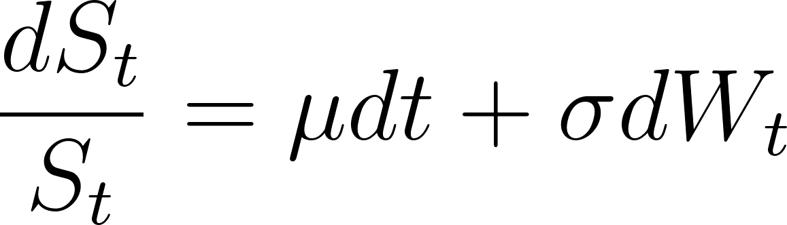
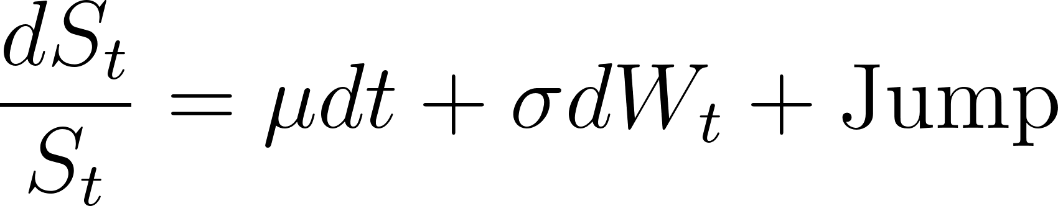
Introduction to Merton's Jump Diffusion Method
Merton's Jump Diffusion model is a financial modeling that think the possibility of sudden jumps in asset prices. Jump processes represent the happen of unexpected events, such as stock news, economic shocks like GDP/911
BSM
JMD
This is the geometric brownian for the stock price follow a diffusion process
"jump" term to the original geometric Brownian motion equation. Jump is Related to arrival(poisson), Size(Log-Normal)

Slide 8
Merton's Jump Diffusion Method assumptions
The asset price follows a geometric Brownian motion, which assumes that the rate of return on the asset is normally distributed.
The asset price can experience sudden jumps or discontinuous movements at random times. These jumps are modeled as a Poisson process.
The size of the jumps follows a log-normal distribution, representing the relative change in the asset price.
The intensity of the jump process is constant over time.
The risk-free interest rate is constant and known.There are no transaction costs or taxes.
The market is frictionless and efficient, with no arbitrage opportunities.

Slide 9
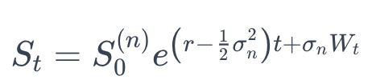
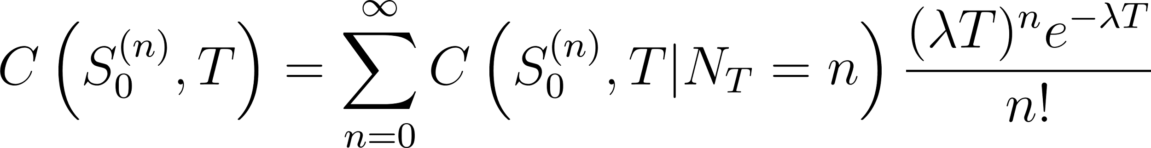




Merton’s Jump-Diffusion Model
Stock Price under merton Jump-Diffusion Model:
Call Option Pricing under merton Jump-Diffusion Model:
is the initial stock price adjusted for n jumps that have occurred up to time zero.
r is the risk-free interest rate.
σ_n is the volatility of the stock return due to the diffusion process, adjusted for n jumps.
W_t is a standard Brownian motion.
The exponent adjusts the expected return by the variance of the stock due to continuous trading, while σ_nW_t captures the random fluctuations.
is the price of the call option at maturity T, given n jumps.
The summation over n accounts for all possible numbers of jumps that could occur by time T.
is the price of the call option given that n specific jumps have occurred by time T.

Slide 10
Applications and Limitations
Applications
Merton's Jump Diffusion Method is commonly used in financial modeling and risk management.
The method can also be applied in other areas such as option pricing, credit risk modeling, and portfolio optimization.
Limitations
Merton's Jump Diffusion Method assumes a continuous-time framework, which may not accurately capture real-world market dynamics.
The method relies on several assumptions, including the distribution of jumps, which may not hold in practice.

Slide 11
Code Initialized Parameters
Init Volatility | v0 | 0.04
Correlation | rho | -0.7
Reversion Rate | kappa | 2
Long-run variance | theta | 0.04
Volatility | sigma | 0.3
Jump intensity | lmbda | 0.5
Description | Symbol | Value
Maturity | T | 1
Strike | K | 100
Interest Rate | r | 0.05
Dividend Rate | q | 0.03
Volatility | sigma | 0.1
Underlying Asset Price Range | S | 50-150
Average Jump Size | mu_j | -0.1
Jump Volatility | sigma_j | 0.2
Jump Intensity | lmbda | 0.5

Slide 12
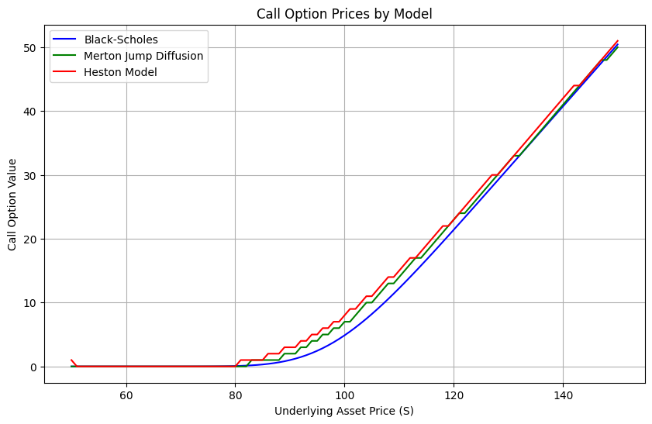
Comparative Analysis：Call Option Values

Slide 13
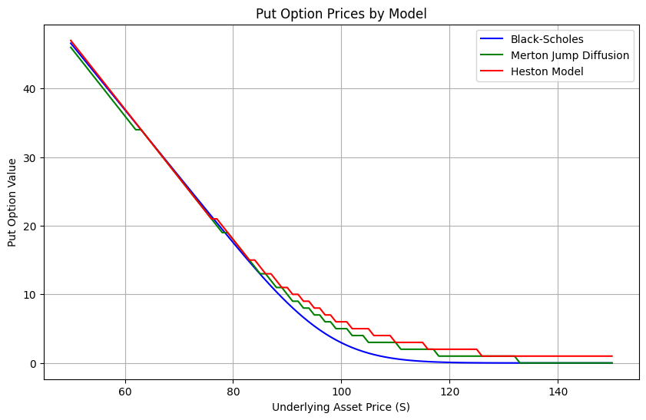
Comparative Analysis：Put Option Values

Slide 14
Conclusion
1.Black-Scholes-Merton (BSM) Model: This is the most basic model for option pricing. It assumes that stock prices follow a Geometric Brownian Motion and that volatility is constant.
2.Heston Model: This model is an advancement of the BSM model. It allows for changing volatility over time, treating both asset prices and volatility as stochastic processes. This improvement aligns the model more closely with actual market behaviors, where volatility is indeed not constant.
3.Merton’s Jump Diffusion Model (MJD): This model enhances the BSM model by introducing a "jump" component. This addition allows for sudden and significant changes in asset prices, mimicking market emergencies. The MJD model combines continuous Brownian motion with randomly occurring jumps to reflect price changes.
Option pricing tends to be highest with Heston, followed by MJD, and lowest with BSM. Heston's higher pricing is attributed to its handling of volatility changes, especially the volatility smile, while MJD's "jump" feature also leads to higher pricing compared to BSM. The dual-process approach of the Heston model makes it more sensitive to price changes, potentially leading to higher option pricing.

Slide 15
Thanks

